Slide 1

Unit V File Management
DEPARTMENT OF COMPUTER SCIENCE AND ENGINEERING

Slide 2

Syllabus
Concept of File, Access methods, File types, File operation, Directory structure, File System structure,
Allocation methods (contiguous, linked, indexed)
Disk Management: Disk structure, Disk scheduling - FCFS, SSTF, SCAN, C-SCAN, Disk reliability,
Disk formatting, Boot-block, Bad blocks
*
Computer engineering and Technology
‹#›

Slide 3
File Management
Files are the central element to most applications
Desirable properties of files:
Long-term existence: Files are stored on disk or other secondary storage and do not disappear when a user logs off.
Sharable between processes: Files have names and can have associated access permissions that permit controlled sharing.
Structure: Depending on the file system, a file can have an internal structure that is convenient for particular applications. In addition, files can be organized into hierarchical or more complex structure to reflect the relationships among files.
*
Computer engineering and Technology
‹#›

Slide 4
Terms in common use when discussing files
3. File
  Is a collection of similar records
  Treated as a single entity and Have file names
  May implement access control mechanisms
4. Database
  Collection of related data
  Relationships exist among elements
  Consists of one or more files
1. Fields
  Basic element of data
  Contains a single value
  Characterized by its length and data type
  E.g. Student name
2. Records
  Collection of related fields
  Treated as a unit
  Fixed /variable length
*
Computer engineering and Technology
‹#›
Notes:
‹#›

Slide 5
File System
The File System is one of the most important part of the OS to a user
Concerned with secondary storage
File systems also provide functions which can be performed on files:
  Create
  Delete
  Open
  Close
  Read
  Write
*
Computer engineering and Technology
‹#›
Notes:
‹#›

Slide 6
File Organization
Refers to the logical structuring of records
Determined by the way in which files are accessed
Important criteria while choosing a file organization:
  Short access time
  Ease of update
  Economy of storage
  Simple maintenance
  Reliability
*
Computer engineering and Technology
‹#›
Notes:
‹#›

Slide 7
File Organization
File Organization Types
  Pile
  Sequential file
  Indexed Sequential file
  Indexed file
  Direct or hashed file
*
Computer engineering and Technology
‹#›
Notes:
‹#›

Slide 8
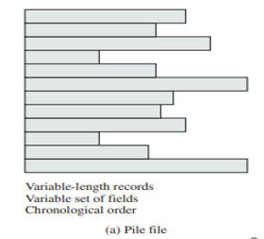
File Organization
Pile
Data are collected in the order they arrive
No structure
Purpose is to accumulate a mass of data and save it
Records may have different fields
Record access is by exhaustive search
Useful when the stored data vary in size and structure.
Easy to update
*
Computer engineering and Technology
‹#›

Slide 9
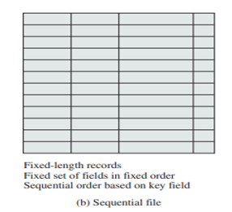
Sequential File
Fixed format used for records
Records are the same length
Key field (first field)
  Uniquely identifies the record
  Records are stored in key sequence
Used in batch applications such as billing/payroll
Easy to store on tape and disk
Not suitable for interactive applications
*
Computer engineering and Technology
‹#›

Slide 10
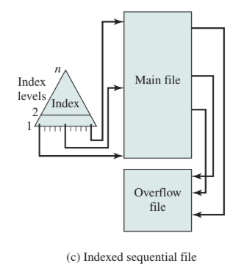
File Organization
Indexed Sequential File
Maintains the key characteristic of the sequential file: records are organized in sequence based on a key field
  An index is added to the file to support random access and overflow file is also added
  Limitation is processing is limited as it is based on a single field of the file.
*
Computer engineering and Technology
‹#›

Slide 11
Indexed Sequential File Example
Imagine you have a very long list of names (1 million students) arranged in alphabetical order.
If you want to find “Ranjana,” you’d have to go through hundreds of thousands of names
Instead of searching the whole list directly, we create a smaller list called an index , like a table of contents in a book.
The index stores only some key entries (say, every 1000th name) along with a pointer showing where that section starts in the main file.
Example index- Key A : points to names starting with A
First, look in the index to find which section target belongs to (e.g., "Ranjana" is under “R”).
Use the pointer from the index to jump directly to that part of the main file.
Continue the search there, but now you only search a small part instead of the whole file.
Example with numbers:
Without an index:
You might check 500,000 records on average before finding the one you want.
With an index of 1,000 entries:
  You first check ~500 entries in the index.
  Then only ~500 more records in the main file.

Slide 12
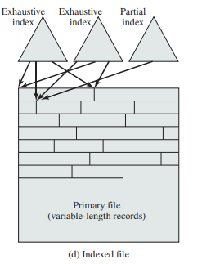
Indexed File
Multiple indexes are employed for a field.
Variable length records can be employed
Two types of indexes are used: exhaustive index (one entry per record) or partial index(one per block or group).
When new records are inserted, all the index files must be updated.
Used in airline reservation systems
*
Computer engineering and Technology
‹#›

Slide 13
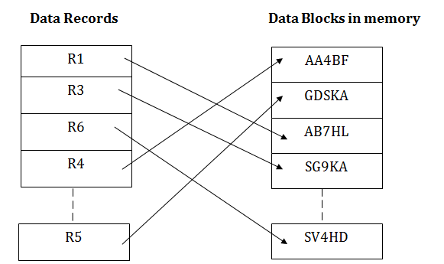
File Organization
  Direct or Hash File
  Directly access a block at a known address
  Key field required for each record
  But there is no concept of sequential ordering
  Makes use of hashing on the key value
  Used where rapid access is required such as Directories
*
Computer engineering and Technology
‹#›

Slide 14
File Directories
Contains information about files
  Attributes
  Location
  Ownership
Provides mapping between file names and the files themselves
A directory system should support a number of operations including:
  Search
  Create files
  Deleting files
  Listing directory
  Updating directory
*
Computer engineering and Technology
‹#›
Notes:
‹#›

Slide 15
Directory Elements
4. Usage Information
Date Created
Identity of Creator
Date Last Read Access
Identity of Last Reader
Date Last Modified
Identity of Last Modifier
Date of Last Backup
Current Usage
  1. Basic Information
  File Name- unique
  File Type- text,binary
  File Organization
  2. Address Information
  Volume -Indicates device on which file is stored
  Starting Address- on secondary storage
  Size Used -Current size of the file in bytes, words, or blocks
  Size Allocated - Maximum size of the file
3. Access Control Information
  Owner :Owner has control of this file & able to grant/deny access to other users and to change these privileges.
  Access Permission: includes the user’s name and password for each authorized user.
  Permitted Actions :Controls reading, writing, executing, and transmitting over a network
‹#›

Slide 16
$ chmod 755 your-script-name
The chmod command modifies the permissions of a file or directory on a Linux system. ... The numbers 755 assign read-write-execute permissions to the user owner and read-execute permissions to group owner and others.
The sums of these numbers give combinations of these permissions:
0 = no permissions whatsoever; this person cannot read, write, or execute the file.
1 = execute only.
2 = write only.
3 = write and execute (1+2)
4 = read only.
5 = read and execute (4+1)
6 = read and write (4+2)
7 = read and write and execute (4+2+1)
*
Computer engineering and Technology
‹#›

Slide 17
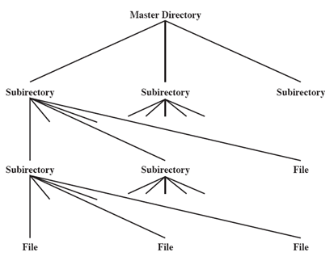
Hierarchical or Tree-Structured Directory
Master directory with user directories underneath it
Each user directory may have subdirectories and files as entries
Naming
Users need to be able to refer to a file by name
Files need to be named uniquely
Tree structure allows users to find a file by following the directory path
Duplicate filenames are possible if they have different pathnames
*
Computer engineering and Technology
‹#›
Notes:
‹#›

Slide 18
File Sharing
In multiuser system, allow files to be shared among users
Two issues
  Access rights
  Management of simultaneous access
    -User may lock entire file when it is to be updated
    -User may lock the individual records during the update
    -Mutual exclusion and deadlock are issues for shared access
  User Classes
Owner - Usually the files creator, has full rights
User Groups - A set of users identified as a group
Others
*
Computer engineering and Technology
‹#›
Notes:
‹#›

Slide 19
File Allocation Methods – Contiguous, Linked, and Indexed”
Definition:
File allocation methods determine how disk blocks are assigned to files.
Purpose:
Efficiently manage storage and access files quickly.
Types:
Contiguous Allocation
Linked Allocation
Indexed Allocation

Slide 20
File Allocation Methods – Contiguous,
An allocation method refers to how disk blocks are allocated for files:
Each file occupies set of contiguous blocks
  Best performance in most cases
  Simple – only starting location (block #) and length (number of blocks) are required
  Problems include:
    Finding space on the disk for a file,
    Knowing file size,
    External fragmentation, need for compaction off-line (downtime) or on-line

Slide 21
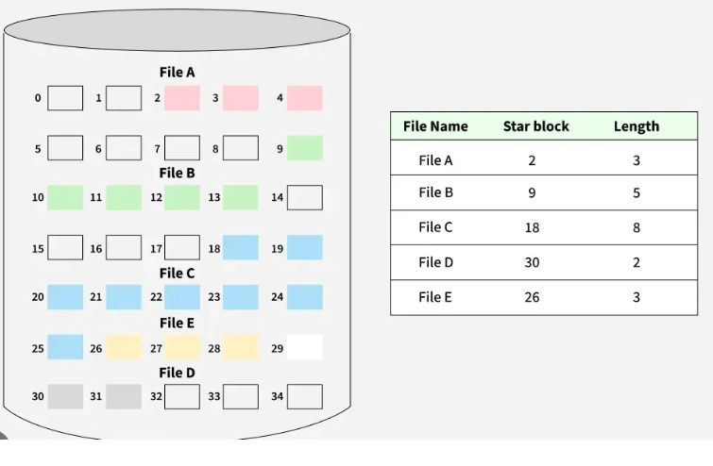
Contiguous Allocation
Each file occupies a set of contiguous (adjacent) blocks on the disk.
Advantages:
Fast sequential and direct access
Simple to implement
Disadvantages:
External fragmentation
Difficult to grow files dynamically

Slide 22
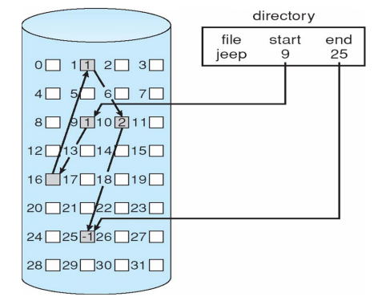
Linked Allocation
Each file is a linked list of disk blocks. Each block contains a pointer to the next block.
Advantages:
No external fragmentation
Easy to grow file size
Disadvantages:
No direct access (only sequential)
Pointer overhead
Possible reliability issue if pointer is lost

Slide 23
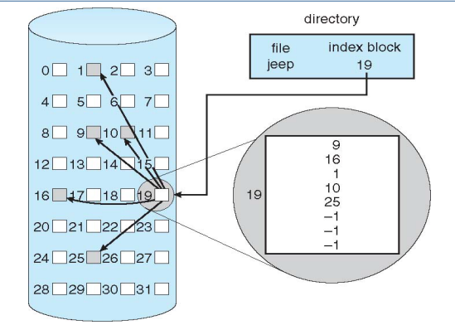
Indexed Allocation
Each file has an index block that contains pointers to all its data blocks.
Advantages:
Supports both sequential and direct access
No external fragmentation
Disadvantages:
Overhead of index block
Small files may waste space

Slide 24
Disk Structure
Disk can be subdivided into partitions
Disks or partitions can be RAID protected against failure
Disk or partition can be used raw – without a file system, or formatted with a file system
Partitions also known as minidisks, slices
Entity containing file system is known as a volume
Each volume containing a file system also tracks that file system’s info in device directory or volume table of contents
In addition to general-purpose file systems there are many special-purpose file systems, frequently all within the same operating system or computer
*
Computer engineering and Technology
‹#›
Notes:
‹#›

Slide 25
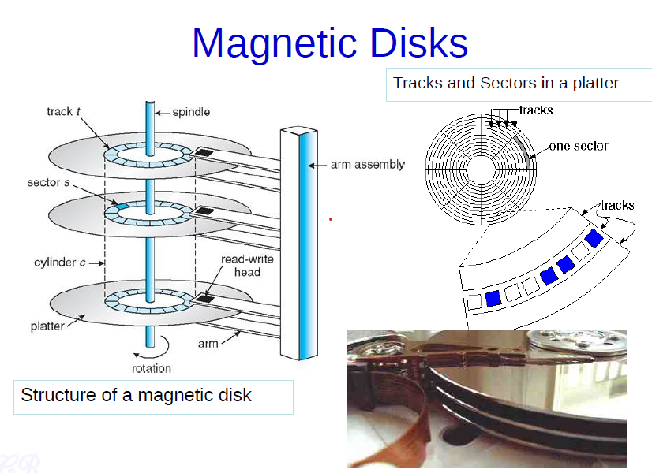
Disk Structure
*
Computer engineering and Technology
‹#›
Notes:
‹#›

Slide 26
Disk Structure
Modern disk drives are addressed as large one-dimensional arrays of where the logical block is the smallest unit of transfer.
The size of a logical block is usually 512 bytes, although some disks can be to have a different logical block size, such as 1,024 bytes.
The one-dimensional array of logical blocks is mapped onto the sectors of the disk sequentially.
Sector 0 is the first sector of the first track on the outermost cylinder.
The mapping proceeds in order through that track, then through the rest of the tracks in that cylinder, and then through the rest of the cylinders from outermost to innermost.
By using this mapping, we can -at least in theory-convert a logical block number into an old-style disk address that consists of a cylinder number, a track number within that cylinder, and a sector number within that track.
*
Computer engineering and Technology
‹#›
Notes:
‹#›

Slide 27
Disk Structure
First, most disks have some defective sectors, but the mapping hides this by substituting spare sectors from elsewhere on the disk.
Second, the number of sectors per track is not a constant on same drives.
On media that use the density of bits per track is uniform.
The further a track is from the center of the disk, the greater its length, so the more sectors it can hold.
*
Computer engineering and Technology
‹#›
Notes:
‹#›

Slide 28
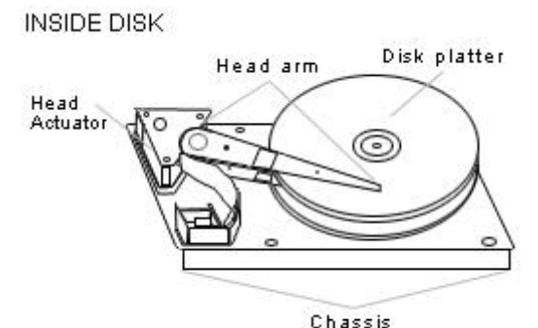
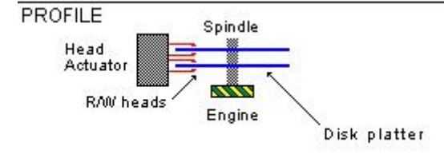
Disk Structure
When the disk drive is operating, the disk is rotating at constant speed
Positioning the Read/Write Head
Track selection involves moving the head to a specific track
*
Computer engineering and Technology
‹#›
Notes:
‹#›

Slide 29
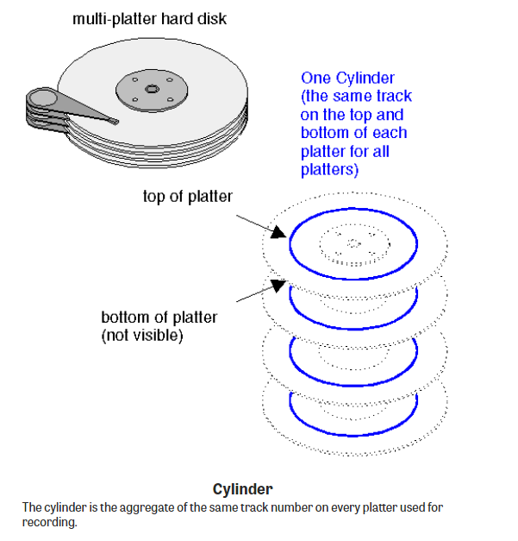
Each surface is divided into tracks (and sectors) in the same way. This means that when the head for one surface is on a track, the heads for the other surfaces are also on the corresponding tracks. All the corresponding tracks taken together are called a cylinder.
*
Computer engineering and Technology
‹#›

Slide 30
Disk Scheduling
A process needs two type of time, CPU time and IO time.
For I/O, it requests the Operating system to access the disk.
However, the operating system must be fare enough to satisfy each request and at the same time, operating system must maintain the efficiency and speed of process execution.
The technique that operating system uses to determine the request which is to be satisfied next is called Disk scheduling.
*
Computer engineering and Technology
‹#›
Notes:
‹#›

Slide 31
Disk Scheduling
Seek Time: is the time taken in locating the disk arm to a specified track where the read/write request will be satisfied.
Rotational Latency: It is the time taken by the desired sector to rotate itself to the position from where it can access the R/W heads.
Transfer Time: It is the time taken to transfer the data.
Disk Access Time: Disk access time is given as,
Disk Access Time = Rotational Latency + Seek Time + Transfer Time
Disk Response Time:It is the average of time spent by each request waiting for the IO operation.
*
Computer engineering and Technology
‹#›
Notes:
‹#›

Slide 32
Disk Scheduling Algorithms
Each algorithm is carrying some advantages and disadvantages. The limitation of each algorithm leads to the evolution of a new algorithm.
FCFS scheduling algorithm
SSTF (shortest seek time first) algorithm
SCAN scheduling
C-SCAN scheduling
*
Computer engineering and Technology
‹#›

Slide 33
Disk Scheduling Policies
To compare various schemes, consider a disk head is initially located at track 100.
  assume a disk with 200 tracks and that the disk request queue has random requests in it
The requested tracks, in the order received by the disk scheduler, are
  55, 58, 39, 18, 90, 160, 150, 38, 184.
*
Computer engineering and Technology
‹#›
Notes:
‹#›

Slide 34
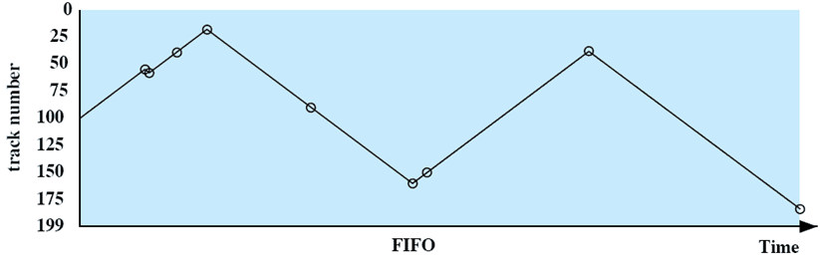
First-in, first-out (FIFO)
Processes requests sequentially in the order received
Fair to all processes
Approaches random scheduling in performance
The requested tracks, in the order received by the disk scheduler, are
  55, 58, 39, 18, 90, 160, 150, 38, 184.
*
Computer engineering and Technology
‹#›
Notes:
‹#›

Slide 35
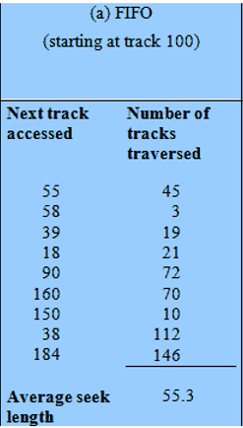
First-in, first-out (FIFO)
Number of tracks traversed by the head
= |55-100|+ |58-55|+|39-58|+|18-39|+|90-18|+|160-90|+|150-160|+|38-150|+|184-38|
= 498
Average seek length= 498/9=55.3
*
COMPUTER ENGINEERING AND TECHNOLOGY
‹#›
Notes:
T
‹#›

Slide 36
FCFS
Consider the following disk request sequence for a disk with 100 tracks 45, 21, 67, 90, 4, 50, 89, 52, 61, 87, 25
Head pointer starting at 50 and moving in left direction. Find the number of head movements in cylinders using FCFS scheduling.
*
Computer engineering and Technology
‹#›

Slide 37
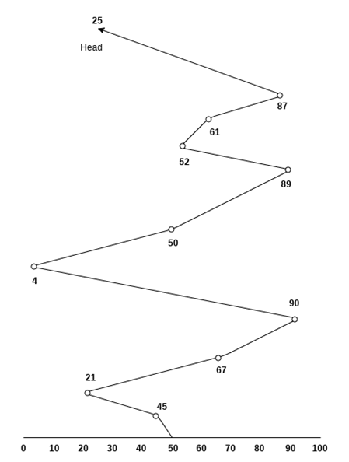
*
Computer engineering and Technology
‹#›

Slide 38
Number of cylinders moved by the head
= (50-45)+(45-21)+(67-21)+(90-67)+(90-4)+(50-4)+(89-50)+(89-52)+(61-52)+(87-61)+(87-25)
= 5 + 24 + 46 + 23 + 86 + 46 + 39 + 37+9 + 26 + 62
= 403
*
Computer engineering and Technology
‹#›

Slide 39
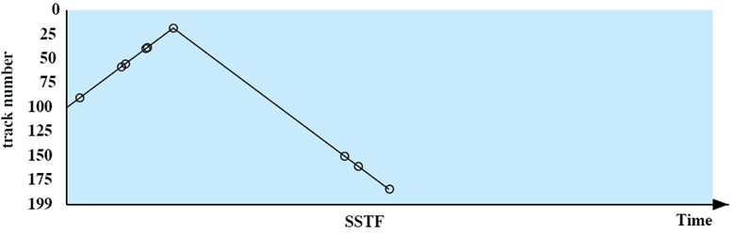
Shortest Service Time First
Select the disk I/O request that requires the least movement of the disk arm from its current position
Always choose the minimum seek time
The requested tracks, in the order received by the disk scheduler, are
  55, 58, 39, 18, 90, 160, 150, 38, 184.
*
Computer engineering and Technology
‹#›
Notes:
‹#›

Slide 40
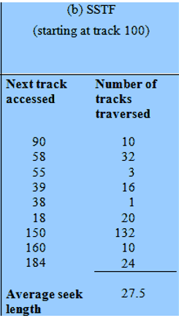
Shortest Service Time First
*
COMPUTER ENGINEERING AND TECHNOLOGY
‹#›
Notes:
T
‹#›

Slide 41
Shortest Service Time First
Disadvantages
It may cause starvation for some requests.
Switching direction on the frequent basis slows the working of algorithm.
It is not the most optimal algorithm.
*
Computer engineering and Technology
‹#›

Slide 42
SCAN
The disk arm starts at one end of the disk, and moves toward the other end, servicing requests until it gets to the other end of the disk, where the head movement is reversed and servicing continues.
SCAN algorithm Sometimes called the elevator algorithm
Illustration shows total head movement of 208 cylinders
But note that if requests are uniformly dense, largest density at other end of disk and those wait the longest

Slide 43
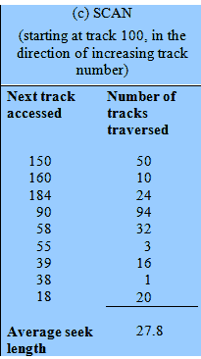
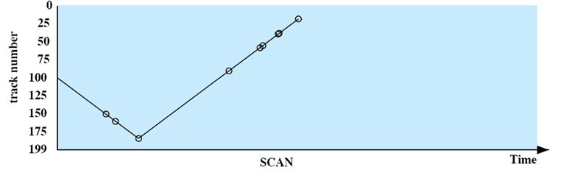
SCAN
55, 58, 39, 18, 90, 160, 150, 38, 184.
Arm moves in one direction only, processing all outstanding requests until it reaches the last track in that direction & then the direction is reversed
*
Computer engineering and Technology
‹#›
Notes:
‹#›

Slide 44
C-SCAN
Provides a more uniform wait time than SCAN
The head moves from one end of the disk to the other, servicing requests as it goes
• When it reaches the other end, however, it immediately returns to the beginning of the disk, without servicing any requests on the return trip
Treats the cylinders as a circular list that wraps around from the last cylinder to the first one
Total number of cylinders?

Slide 45
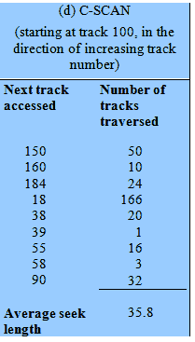
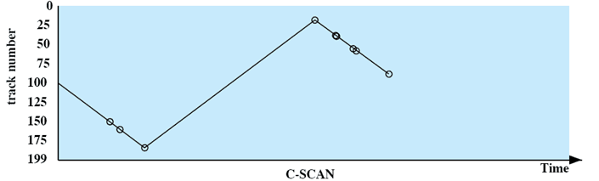
C-SCAN
55, 58, 39, 18, 90, 160, 150, 38, 184.
Restricts scanning to one direction only
When the last track has been visited in one direction, the arm is returned to the opposite end of the disk and the scan begins again
*
Computer engineering and Technology
‹#›
Notes:
‹#›

Slide 46
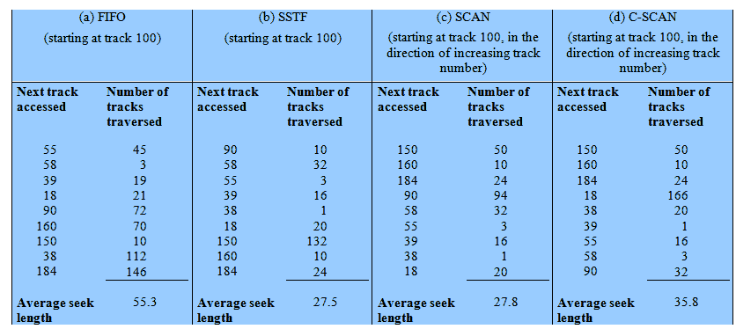
Performance Compared
Comparison of Disk Scheduling Algorithms
*
Computer engineering and Technology
‹#›
Notes:
T
‹#›

Slide 47


Slide 48
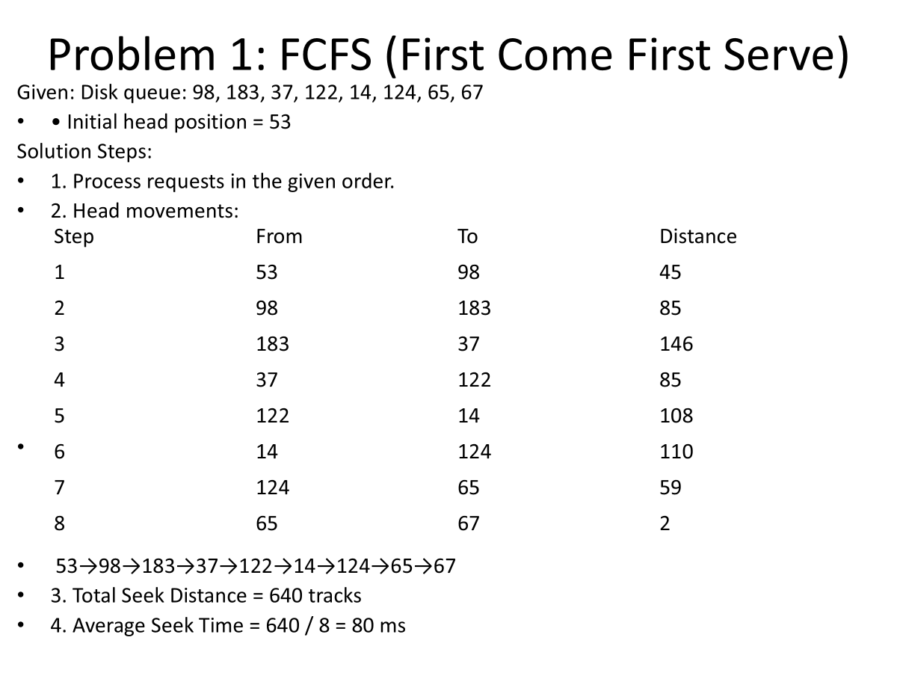

Slide 49
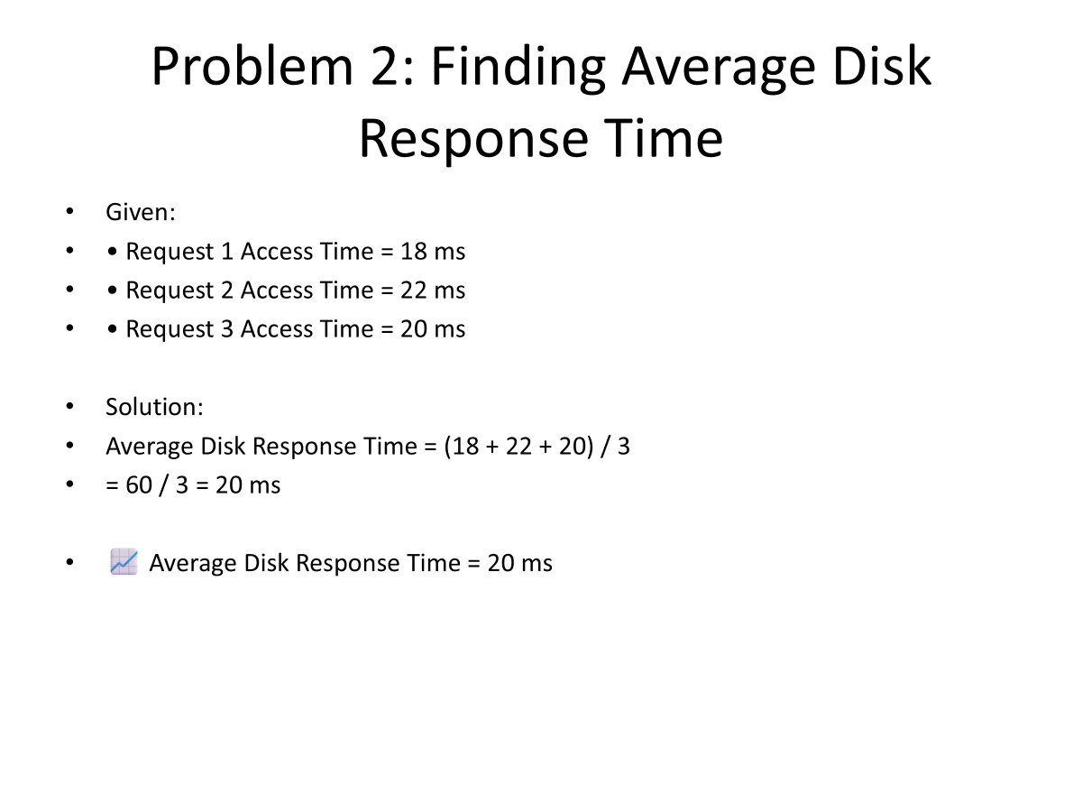
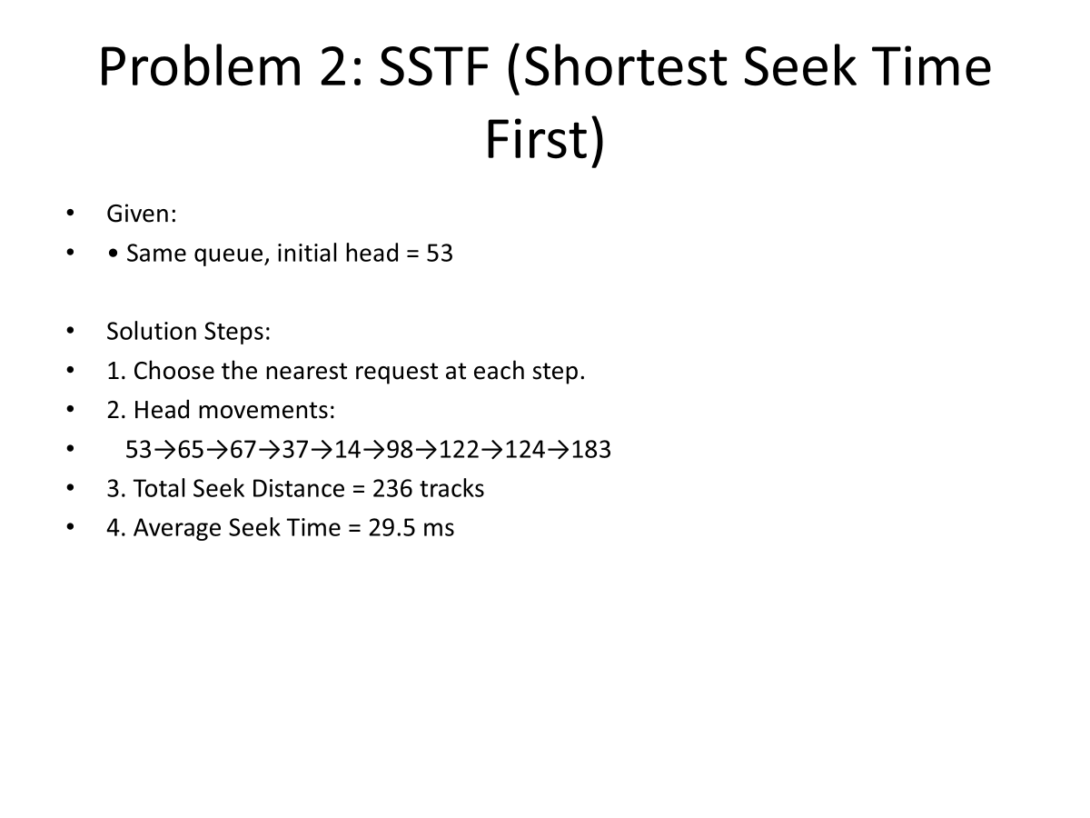

Slide 50
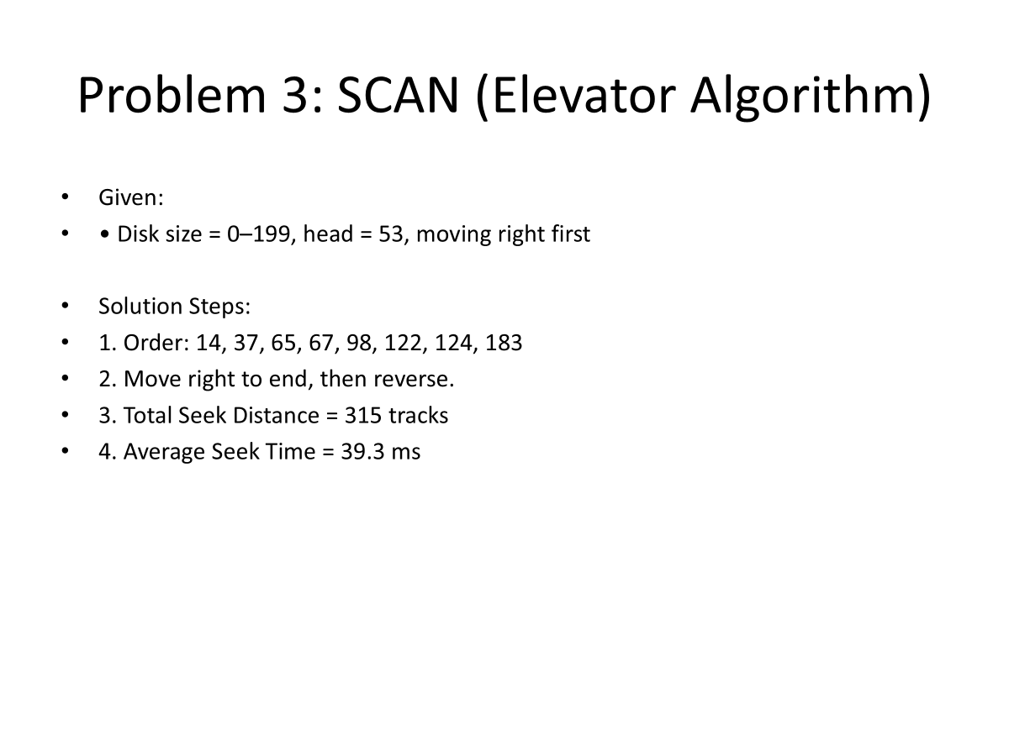

Slide 51
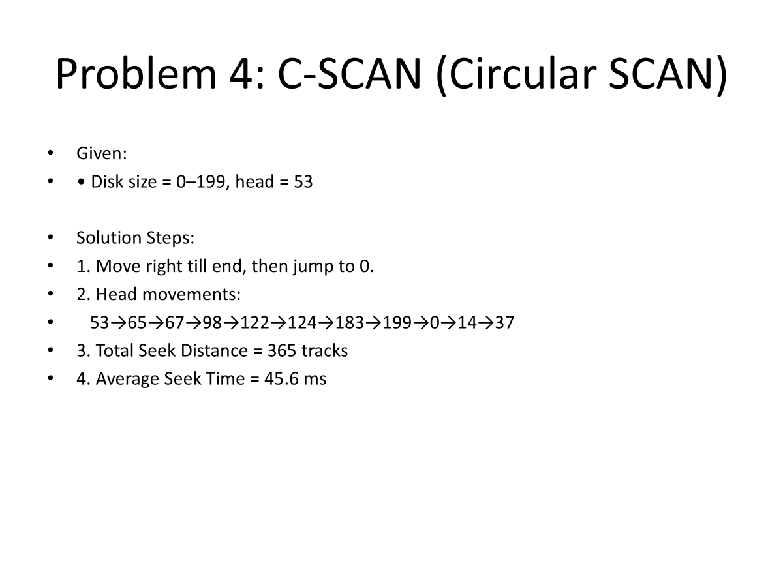

Slide 52
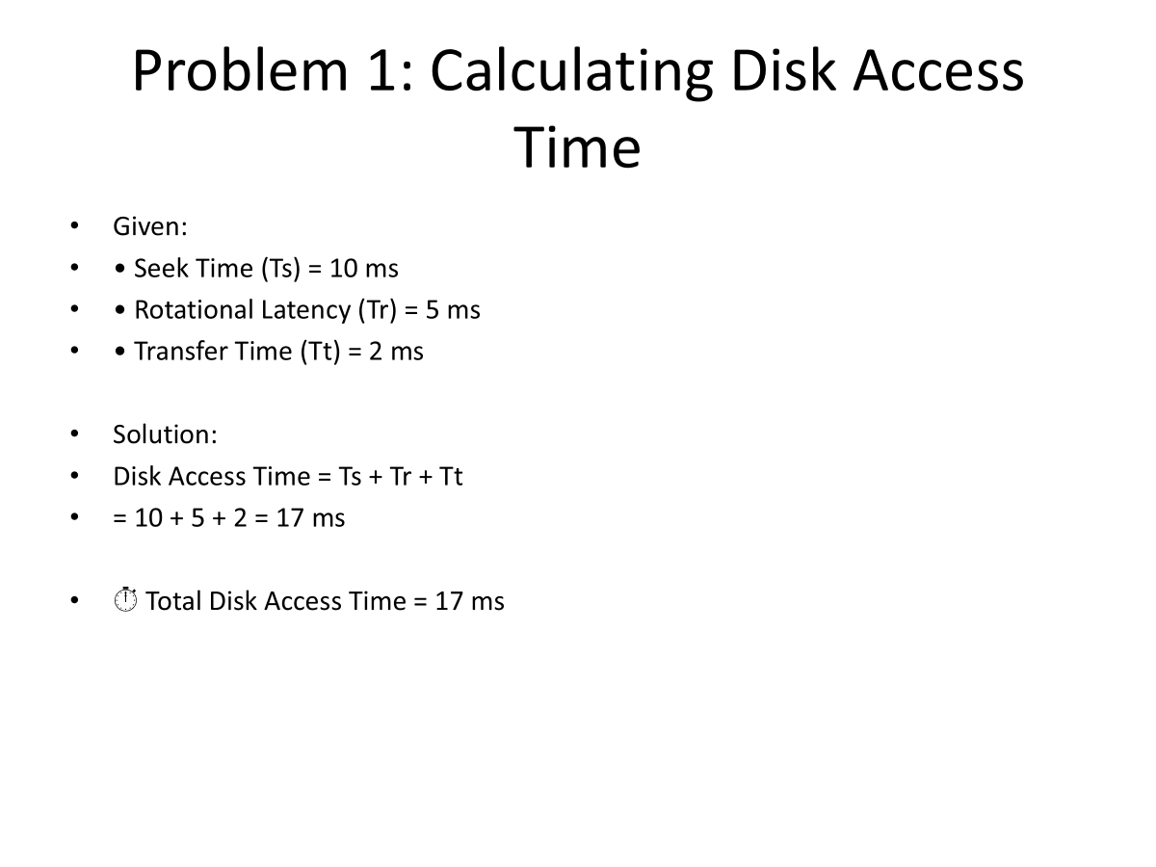

Slide 54
Disk Formatting
A new magnetic disk is a blank slate: It is just a platter of a magnetic recording material.
Before a disk can store data, it must be divided into sectors that the disk controller can read and write. This process is called low-level formatting, or physical formatting.
Low-level formatting fills the disk with a special data structure for each sector. The data structure for a sector typically consists of a header, a data area (usually 512 bytes in size), and a trailer.
The header and trailer contain information used by the disk controller, such as a sector number and an error-correcting code (ECC)
When the controller writes a sector of data during normal I/O, the ECC is updated with a value calculated from all the bytes in the data area.
When the sector is read, the ECC is recalculated and is compared with the stored value.
If the stored and calculated numbers are different, this mismatch indicates that the data area of the sector has become corrupted and that the disk sector may be bad
*
Computer engineering and Technology
‹#›
Notes:
‹#›

Slide 55
Disk Formatting
The controller automatically does the ECC processing whenever a sector is read or ,written.
Most hard disks are low-level-formatted at the factory as a part of the manufacturing process.
For many hard disks, when the disk controller is instructed to low-Level-formatting, it can also be told how many bytes of data space to leave between the header and trailer of all sectors.
It is usually possible to choose among a few sizes, such as 256, 512, and 1,024 bytes.
Formatting a disk with a larger sector size means that fewer sectors can fit on each track; but it also means that fewer headers and trailers are written on each track and more space is available for user data.
Some operating systems can handle only a sector size of 512 bytes.
*
Computer Engineering and Technology
‹#›
Notes:
‹#›

Slide 56
Disk Formatting
To use a disk to hold files, the operating system still needs to record its own data structures on the disk.
The first step is to partition the disk into one or more groups of cylinders.
The operating system can treat each partition as though it were a separate disk.
Eg, one partition can hold a copy of the operating system's executable code, while another holds user files.
After partitioning, the second step is logical formatting (or creation of a file system). In this step, the operating system stores the initial file-system data structures onto the disk.
These data structures may include maps of free and allocated space (a FAT or inodes) and an initial empty directory.
*
Computer engineering and Technology
‹#›
Notes:
‹#›

Slide 57
Disk Formatting
To increase efficiency, most file systems group blocks together into larger chunks, frequently called clusters.
Disk I/O is done via blocks, but file system I/O is done via clusters, effectively assuring that I/O has more sequential-access and fewer random-access characteristics.
Some operating systems give special programs the ability to use a disk partition as a large sequential array of logical blocks, without any file-system data structures.
This array is sometimes called the raw disk, and I/O to this array is termed raw I/O. For example, some database systems prefer raw I/O because it enables them to control the exact disk location where each database record is stored.
Raw I/O bypasses all the file-system services, such as the buffer cache, file locking, prefetching, space allocation, file names, and directories.
*
Computer engineering and Technology
‹#›
Notes:
‹#›

Slide 58
Boot Block
For a computer to start running-for instance, when it is powered up or rebooted-it must have an initial program to run.
This initial bootstrap program tends to be simple. It initializes all aspects of the system, from CPU registers to device controllers and the contents of main memory, and then starts the operating system.
To do its job, the bootstrap program finds the operating- system kernel on disk, loads that kernel into memory, and jumps to an initial address to begin the operating-system execution.
For most computers, the bootstrap is stored in read-only memory (ROM). This location is convenient, because ROM needs no initialization and is at a fixed location that the processor can start executing when powered up or reset.
*
Computer engineering and Technology
‹#›
Notes:
‹#›

Slide 59
Boot Block
And, since ROM is read only, it cannot be infected by a computer virus. The problem is that changing this bootstrap code requires changing the ROM hardware chips.
For this reason, most systems store a tiny bootstrap loader program in the boot ROM whose only job is to bring in a full bootstrap program from disk.
The full bootstrap program can be changed easily: A new version is simply written onto the disk.
The full bootstrap program is stored in "the boot blocks" at a fixed location on the disk. A disk that has a boot partition is called a boot disk or system disk.
The code in the boot ROM instructs the disk controller to read the boot blocks into memory (no device drivers are loaded at this point) and then starts executing that code.
The full bootstrap program is more sophisticated than the bootstrap loader in the boot ROM; it is able to load the entire operating system from a non-fixed location on disk and to start the OS running
Computer engineering and Technology
‹#›
Notes:
‹#›

Slide 60
Boot Block
Example the boot process in Windows 2000-
The Windows 2000 system places its boot code in the first sector on the hard disk (which it terms the master boot record, or MBR).
Windows 2000 allows a hard disk to be divided into one or more partitions; one partition, identified as the boot partition, contains the operating system and device drivers.
Booting begins in a Windows 2000 system by running code that is resident in the system's ROM memory.
This code directs the system to read the boot code from the MBR. In addition to containing boot code, the MBR contains a table listing the partitions for the hard disk and a flag indicating which partition the system is to be booted from.
Once the system identifies the boot partition, it reads the first sector from that partition (which is called the boot sector) and continues with the remainder of the boot process, which includ.es loading the various subsystems and system services.
*
Computer engineering and Technology
‹#›
Notes:
‹#›

Slide 61
Bad Blocks
As disks have moving parts and small tolerances, they are prone to failure. Sometimes the failure is complete; in this case, the disk needs to be replaced and its contents restored from backup media to the new disk.
one or more sectors become defective. Most disks even come from the factory with bad blocks. Depending on the disk and controller in use, these blocks are handled in a variety of ways.
On simple disks, such as some disks with IDE controllers, bad blocks are handled manually. For instance, the MS-DOS format command performs logical formatting and, as a part of the process, scans the disk to find bad blocks.
If format finds a bad block, it writes a special value into the corresponding FAT entry to tell the allocation routines not to use that block.
If blocks go bad during normal operation, a special program (such as chkdsk) must be run manually to search for tIle bad blocks and to lock them away as before.
Data that resided on the bad blocks usually are lost.
*
Computer engineering and Technology
‹#›
Notes:
‹#›

Slide 62
Bad Blocks
More sophisticated disks, such as the SCSI disks used in high-end PCs and most workstations and servers are smarter about bad-block recovery.
The controller maintains a list of bad blocks on the disk.
The list is initialized during the low-level formatting at the factory and is updated over the life of the disk.
Low-level formatting also sets aside spare sectors not visible to the operating system.
The controller can be told to replace each bad sector logically with one of the spare sectors.
This scheme is known as sector sparing or forwarding.
*
Computer engineering and Technology
‹#›
Notes:
‹#›

Slide 63
Bad Blocks
A typical bad-sector transaction might be as follows:
The operating system tries to read logical block 87.
The controller calculates the ECC and finds that the sector is bad. It reports this finding to the operating system.
The next time the system is rebooted, a special command is run to tell the SCSI controller to replace the bad sector with a spare.
After that, whenever the system requests logical block 87, the request is translated into the replacement sector's address by the controller.
*
Computer engineering and Technology
‹#›
Notes:
‹#›

